Slide 1
Introduction to R for Biologists Day 1 – Intro to R and the Tidyverse Ecosystem Developed by Rachael Cox

Slide 2


Welcome to Class!!
Philip Sweet, Ph.D.
(he/him)
Instructor
Research Fellow
Alexandra Lukasiewicz (she/her)
Teaching Assistant
Ph.D. Candidate

Slide 3
Course Summary
Day 1: Introduction to R syntax and the Rstudio Interface
Day 2: Making plot in the Tidyverse (ggplot)
Day 3: Manipulating data in the Tidyverse (dplyr)
Day 4: Statistical Applications of R

Slide 4
Course Format
Concept Slides and Code Along Activities
Lecture -> Coding -> Lecture -> Coding
Check email for link to my Github
https://github.com/philipjsweet/R4Biology

Slide 5
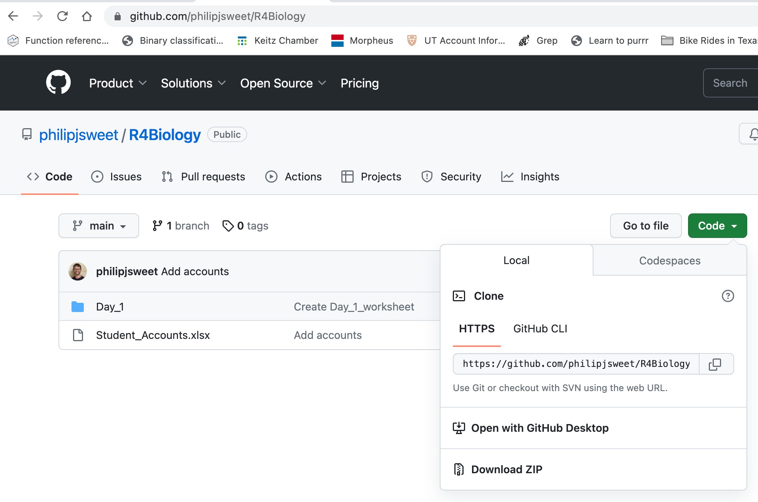
Course Format

Slide 6
Course Format

Slide 7
Day 1 Outline
How to get set up using R
How and why to use RStudio & R Markdown (.Rmd)
Basics of programming
Data types
Functions
Troubleshooting
Intro to the Tidyverse
Tidy vs untidy data
Tidyverse-specific functions
Notes:
We’re going to cover a lot of information in this class. Feel free to interrupt me with questions or ask questions in the chat. The results of the survey indicate about 1/3 of the class has no prior coding experience, so I’m going to set a slow pace.

Slide 8

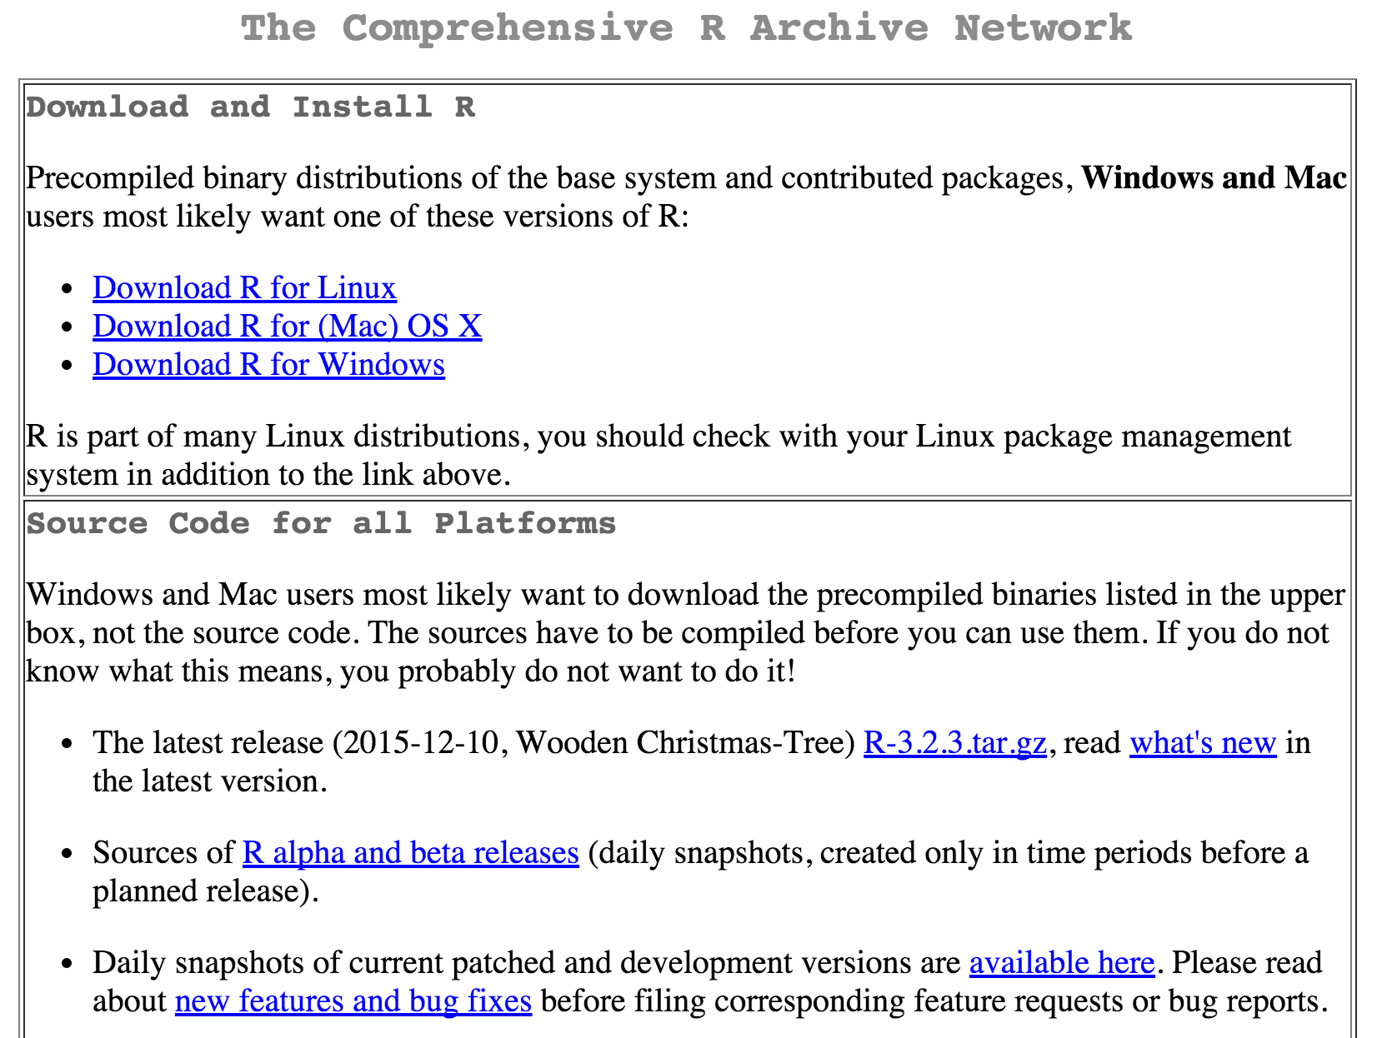
R: The premier data analysis and visualization platform
https://cran.r-project.org/
Notes:
For this class we’ll be using a compute server that’s run by the

Slide 9

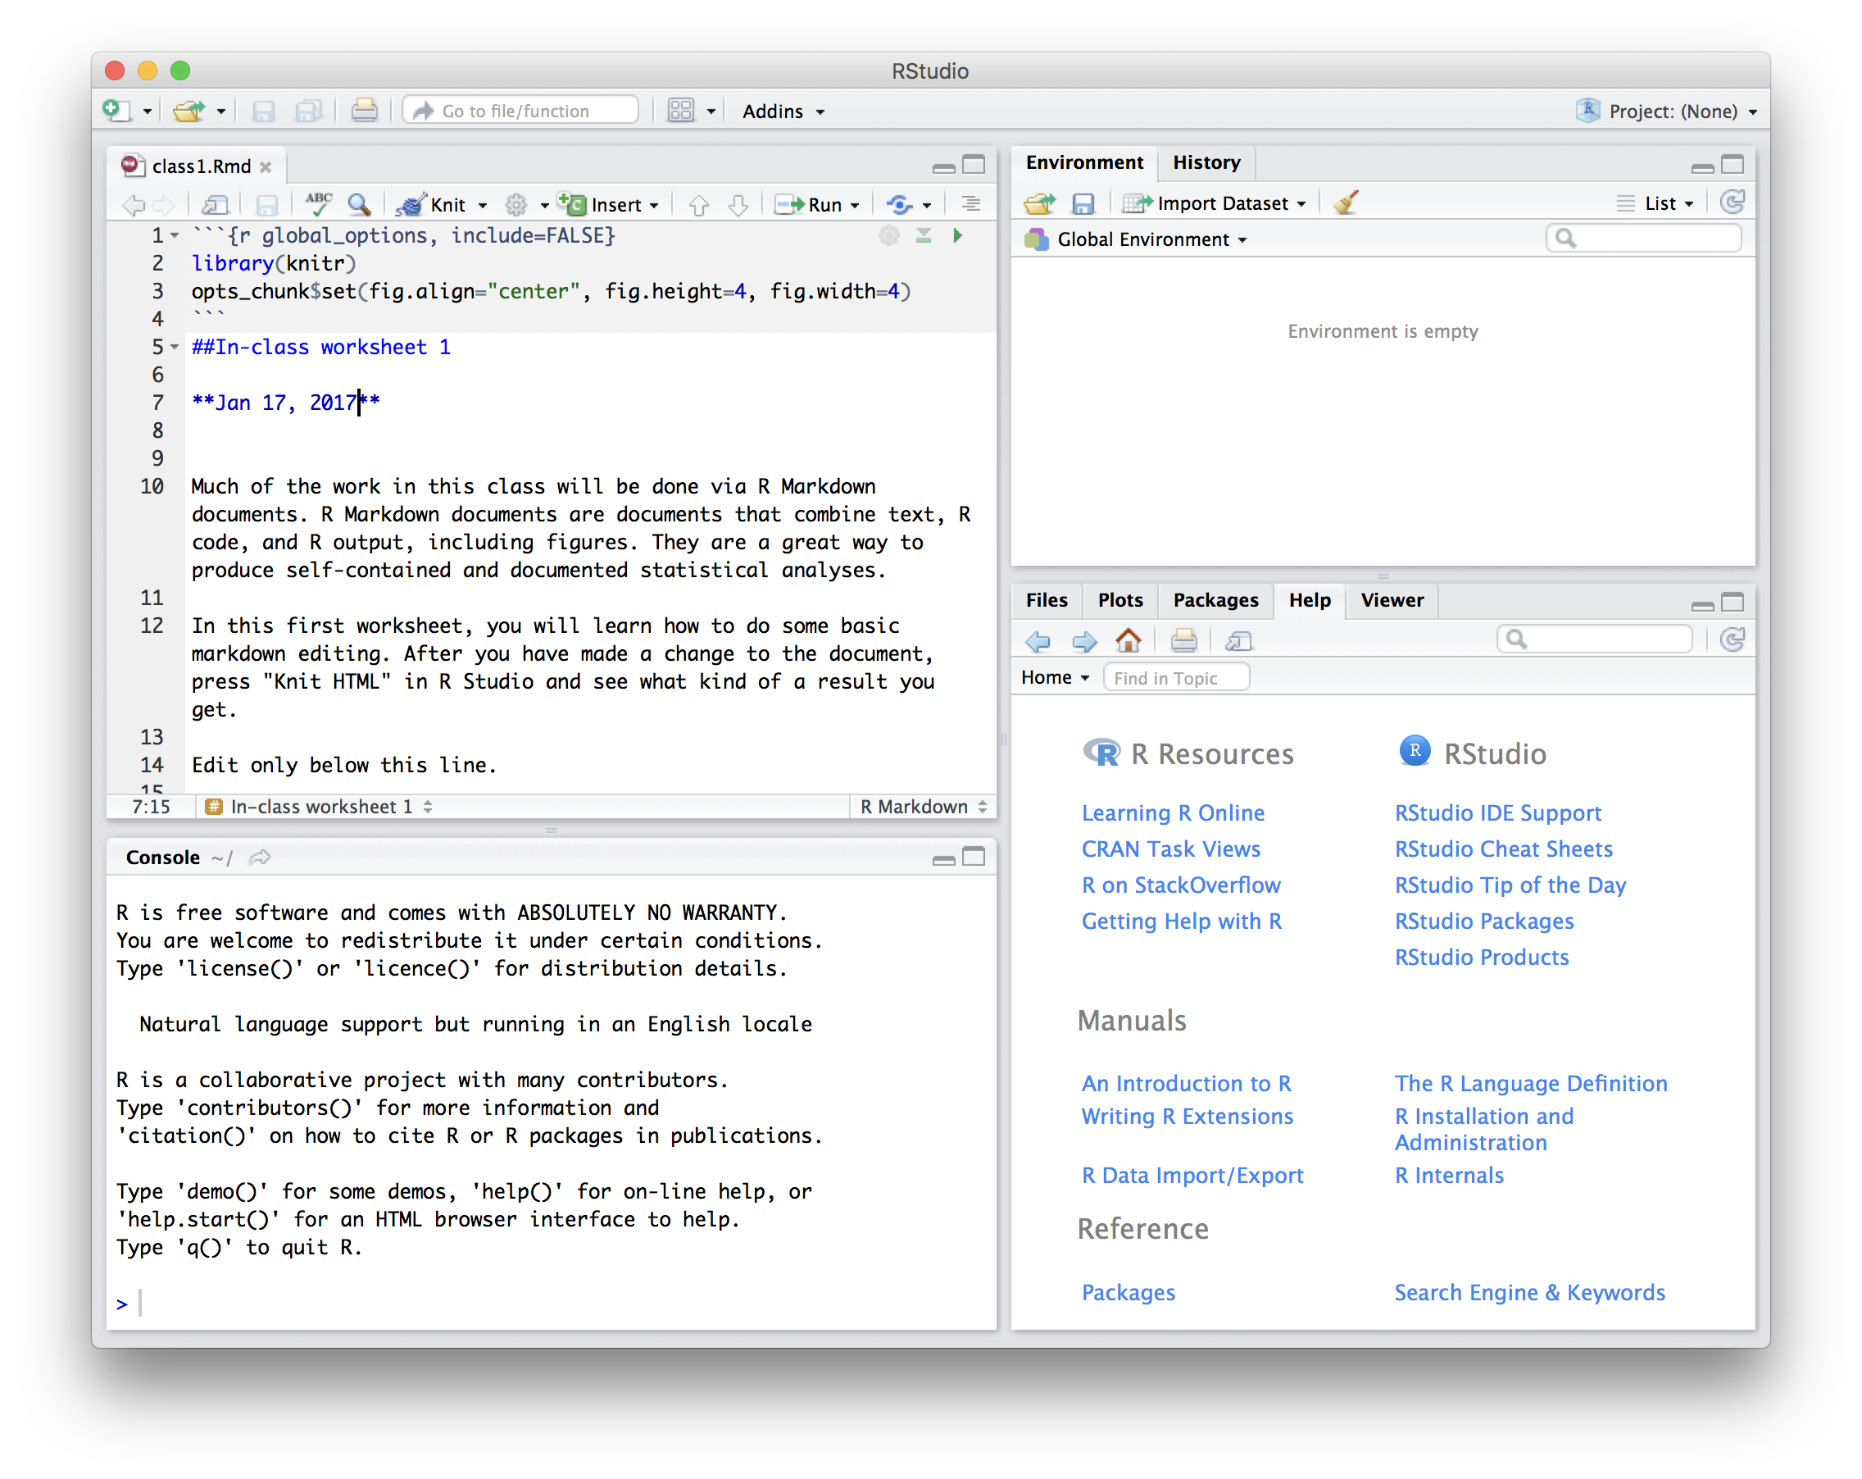
R Studio: A nice user interface for R
https://www.rstudio.com/products/rstudio/download/

Slide 10
Access R Studio through your web browser
https://gsafcomp01.ccbb.utexas.edu/
https://gsafcomp02.ccbb.utexas.edu/

Slide 11
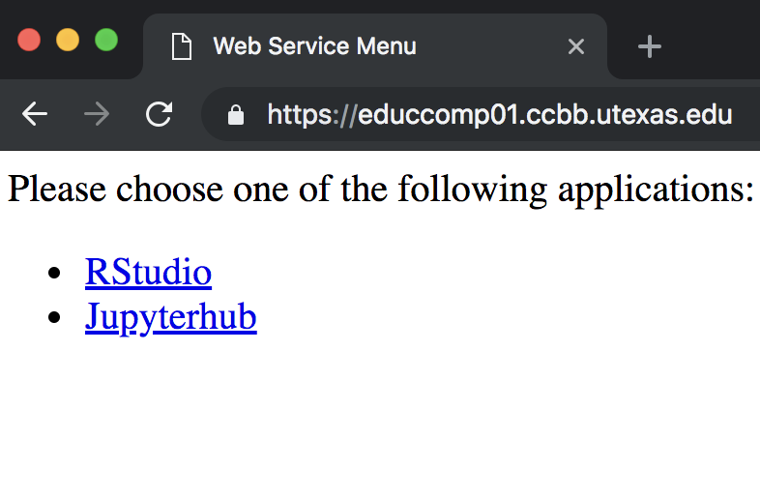
Select RStudio

Slide 12
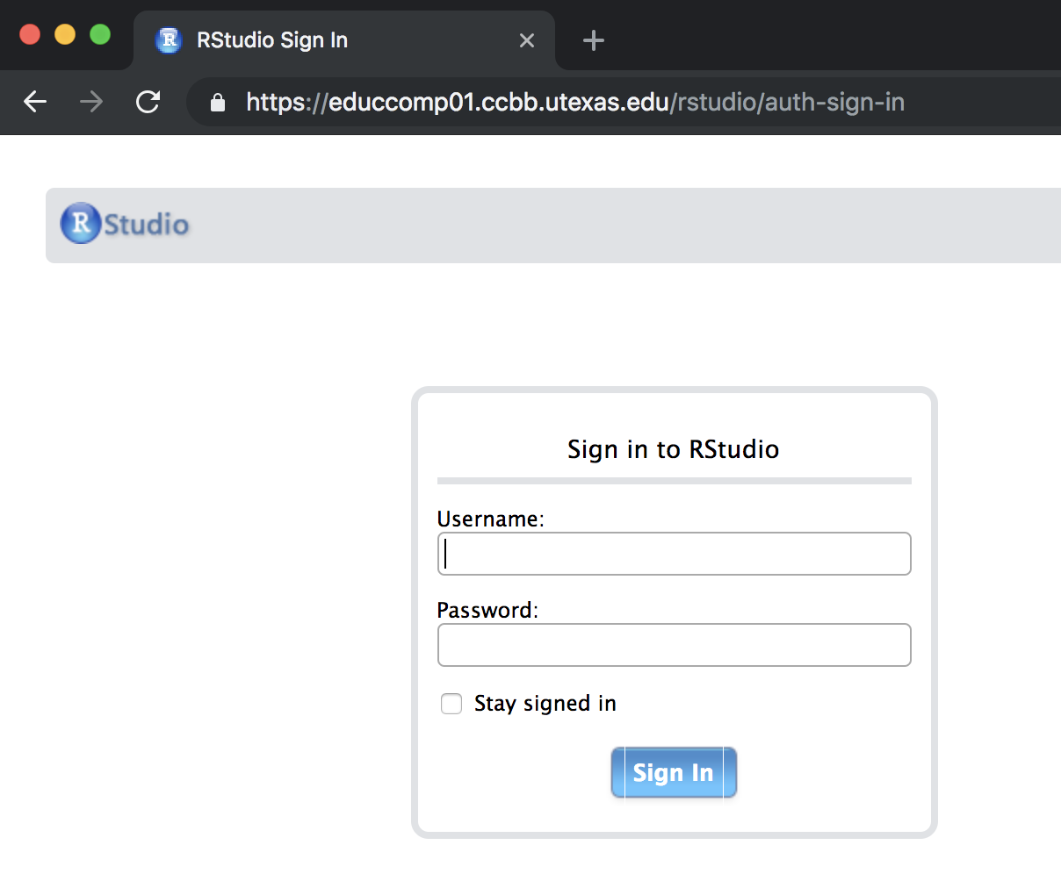
Sign in with your student# and password
Refer to class email for your individual username
Notes:
Let everyone sign in, go over how to customize theme and output

Slide 13
R Markdown
Notes:
Computational analyses require methods and notes to be recorded the same way you would for wet lab experiments. An excellent way to do this is via R Markdown documents. R Markdown documents are documents that combine text, R code, and R output, including figures. They are a great way to produce self-contained and documented statistical analyses.

Slide 14
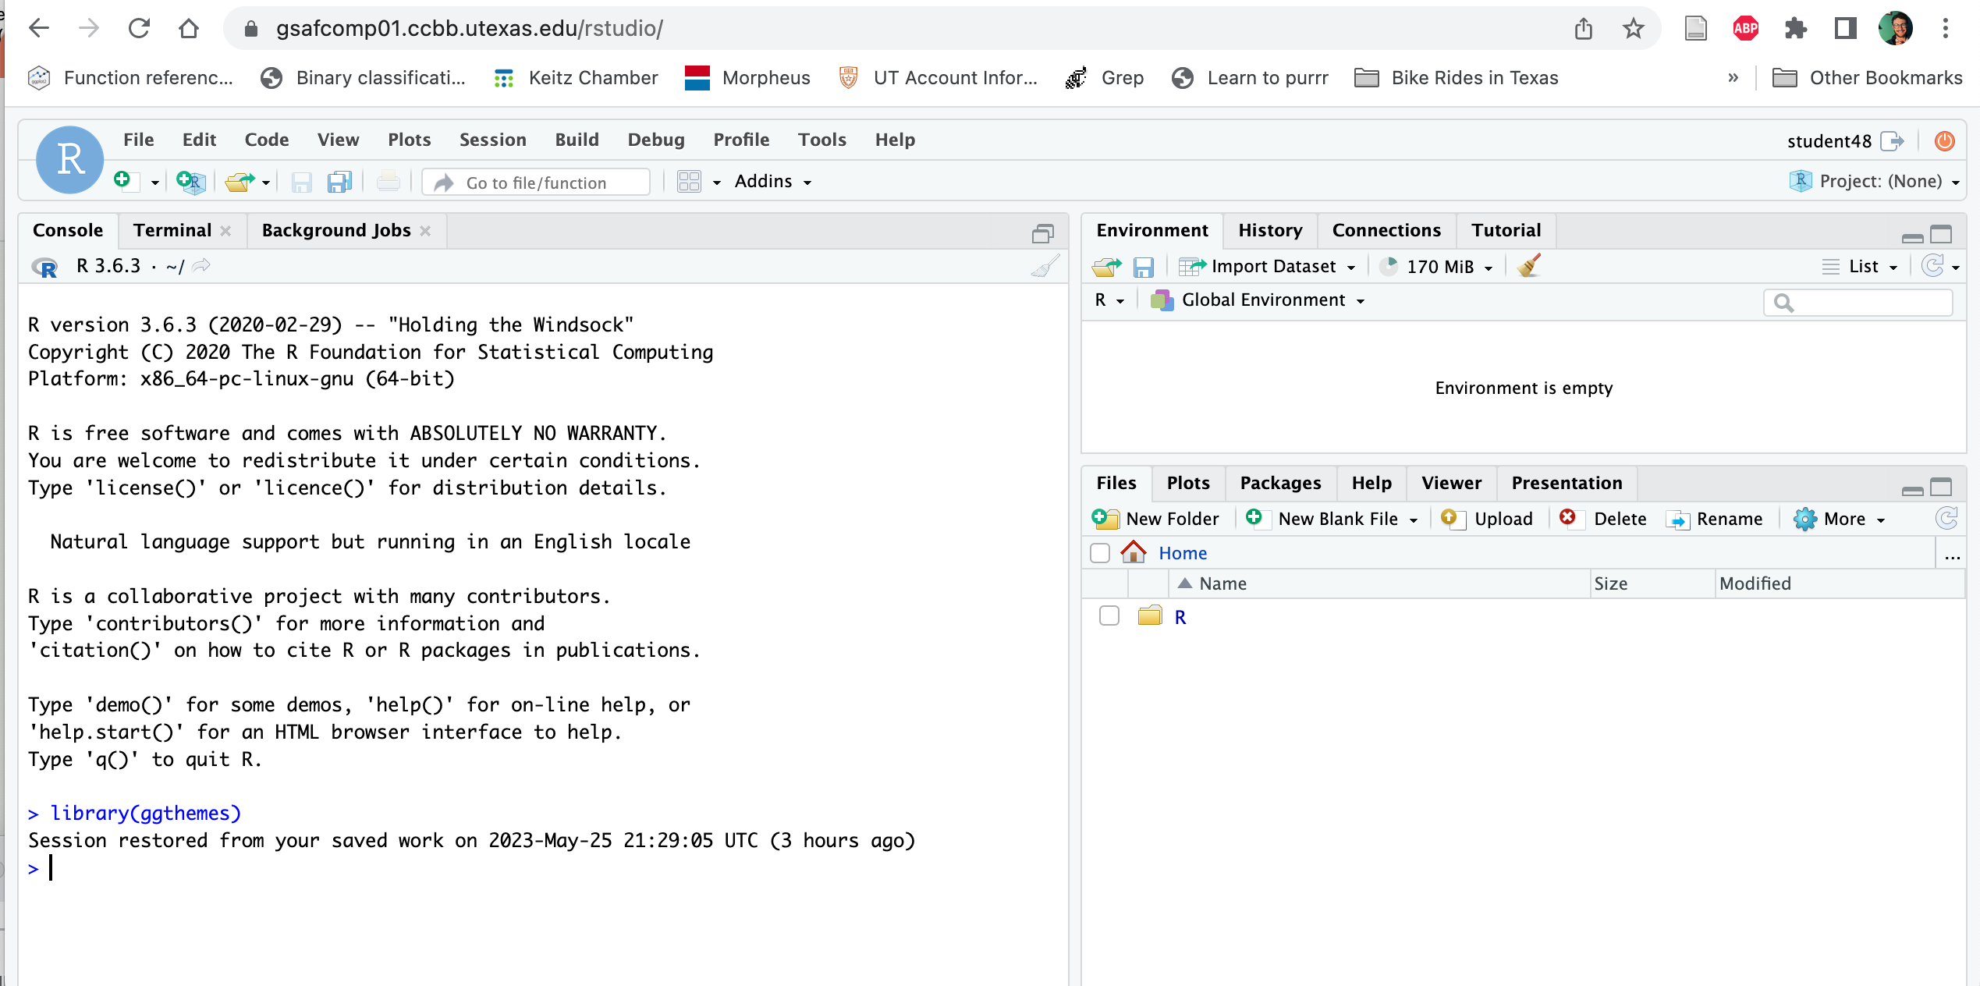
R Markdown: Open the markdown
Notes:
We can organize code and notes by using specific syntax inside a .Rmd file

Slide 15
R Markdown: Open the markdown
Notes:
We can organize code and notes by using specific syntax inside a .Rmd file

Slide 16
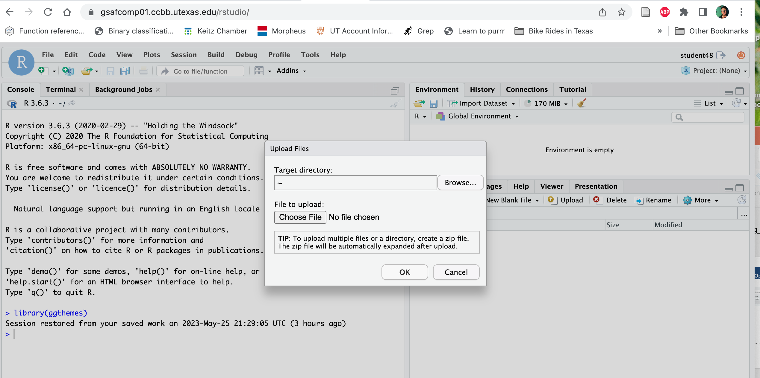
R Markdown: Open the markdown
Notes:
We can organize code and notes by using specific syntax inside a .Rmd file

Slide 17
R Markdown: Open the markdown
Notes:
We can organize code and notes by using specific syntax inside a .Rmd file

Slide 18
R Markdown: Open the markdown
Demonstration Time!!
Notes:
We can organize code and notes by using specific syntax inside a .Rmd file

Slide 19
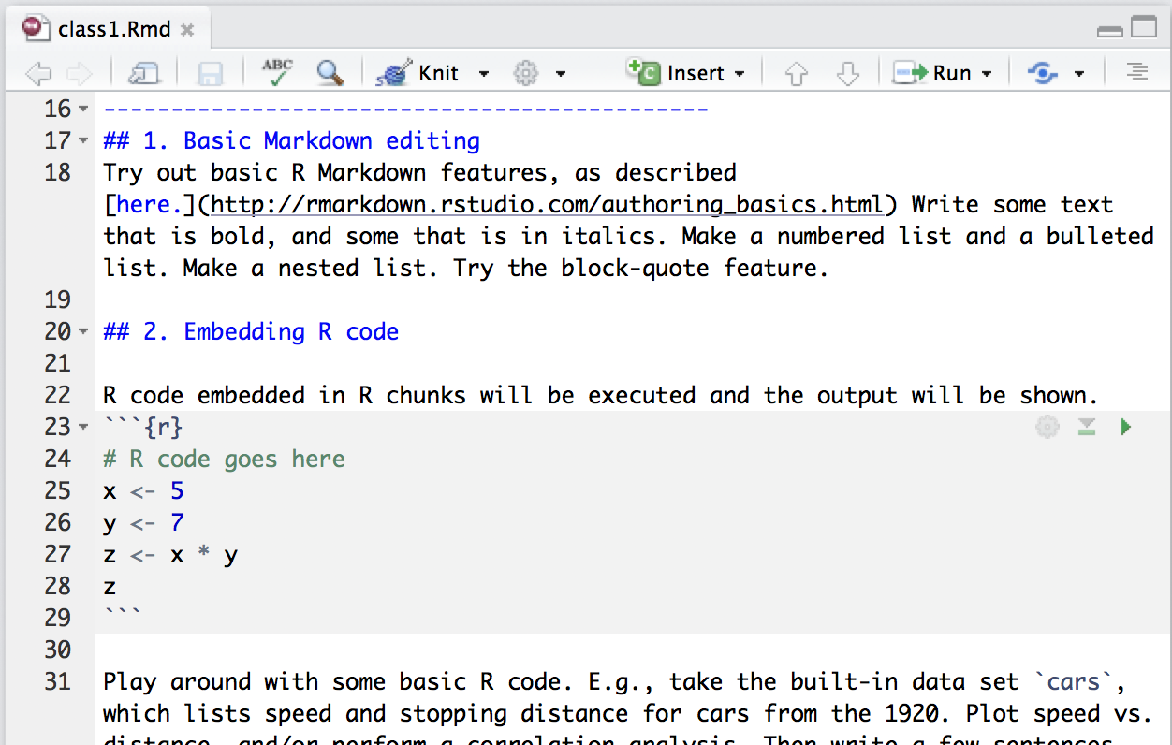
R Markdown: Writing documents with embedded R code
Notes:
We can organize code and notes by using specific syntax inside a .Rmd file

Slide 20
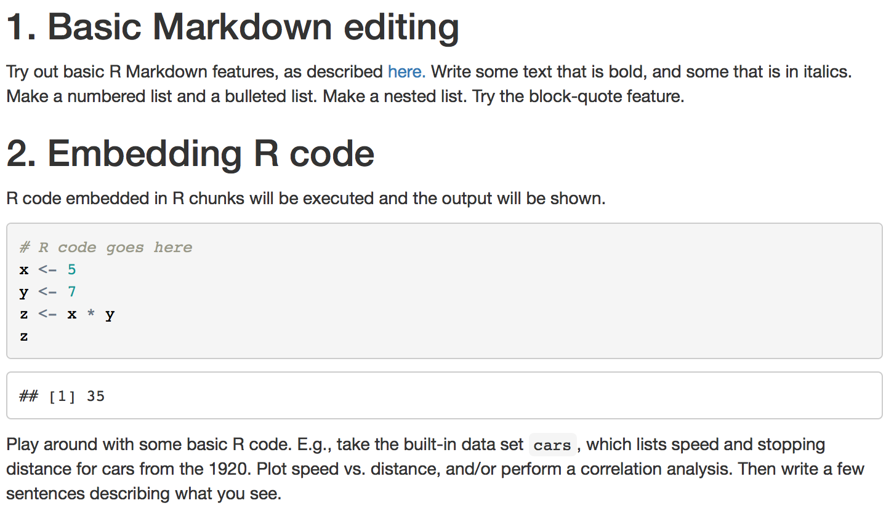
R Markdown: Writing documents with embedded R code
Notes:
And then when we can use the “Knit” tool to create a nice PDF or HTML of the document (check out HTML on the website)

Slide 21
We convert R Markdown to HTML by “knitting” the Markdown file

Slide 22
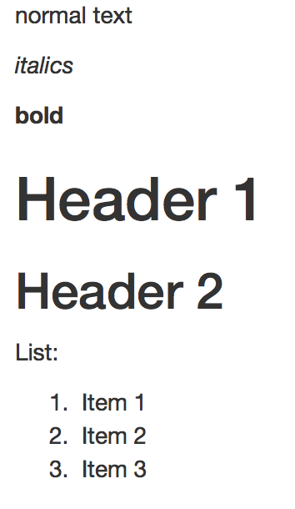
Markdown basics
http://rmarkdown.rstudio.com/authoring_basics.html
normal text
*italics*
**bold**
# Header 1
## Header 2
List:
1. Item 1
2. Item 2
3. Item 3

Slide 23
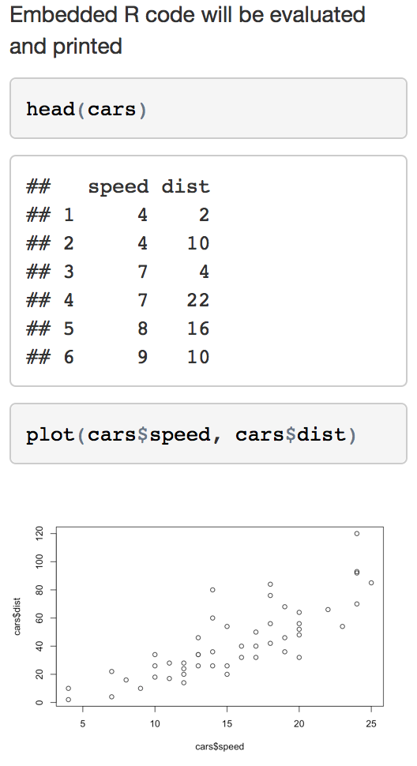
Markdown basics
Embedded R code will be evaluated and printed
```{r}
head(cars)
plot(cars$speed, cars$dist)
```

Slide 24
Different ways to execute code in RStudio

Slide 25
Press the “Run” button

Slide 26
Highlight code you want to execute and press ctrl+Enter (cmd+Enter on Macs)

Slide 27
Place pointer on line of code you want to execute, press ctrl+Enter (cmd+Enter on Macs)

Slide 28
Use ctrl+Shift+Enter (cmd+Shift+Enter on Macs) to execute an entire code chunk

Slide 29
Shortcuts for coding
Ctrl+Shift+M (Cmd+Shift+M on Macs) produces a pipe operator %>% (will be used with the tidyverse)
Ctrl+Shift+C (Cmd+Shift+C on Macs) will comment/uncomment a line or multiple lines
Tab and Shift+Tab will indent and un-indent lines, respectively

Slide 30
Your turn!
Try Example #1 and #2
Stuck? Raise your hand and we’ll come around

Slide 31
R Programming Basics

Slide 32
Assignments, numbers, vectors
> x <- 5
> x
[1] 5
Assign number 5 to variable x
> 5*x^2+7
[1] 132
Calculate 5*x²+7
> y <- c(1, 2, 3, 4, 5)
> y
[1] 1 2 3 4 5
Create vector, assign
to variable y
> x*y
[1] 5 10 15 20 25
Multiply each element
in y with the number in x

Slide 33
Strings
A string contains text:
> name <- “Rachael Cox"
> name
[1] “Rachael Cox"
A vector of strings:
> animals <- c("cat", "mouse", "mouse", "cat", "rabbit")
> animals
[1] "cat" "mouse" "mouse" "cat" "rabbit"

Slide 34
Factors
Factors keep track of distinct categories (levels) in a vector:
> animals
[1] "cat" "mouse" "mouse" "cat" "rabbit”
> factor(animals)
[1] cat mouse mouse cat rabbit
Levels: cat mouse rabbit

Slide 35
Data frames
We use data frames to store data sets with multiple variables:
> pets <- data.frame(
family = c(1, 2, 3, 4, 5),
pet = animals
)
> pets
family pet
1 1 cat
2 2 mouse
3 3 mouse
4 4 cat
5 5 rabbit

Slide 36
Data frames
We access individual columns in a data frame with $ + the column name:
> pets$family
[1] 1 2 3 4 5
> pets$pet
[1] cat mouse mouse cat rabbit
Levels: cat mouse rabbit

Slide 37
Demonstration Time!
Work on Section #3

Slide 38
Data frames
R has many built-in data frames:
> cars
speed dist
1 4 2
2 4 10
3 7 4
4 7 22
5 8 16
6 9 10
7 10 18
8 10 26
9 10 34
> chickwts
weight feed
1 179 horsebean
2 160 horsebean
3 136 horsebean
4 227 horsebean
... ... ...
11 309 linseed
12 229 linseed
13 181 linseed
14 141 linseed

Slide 39
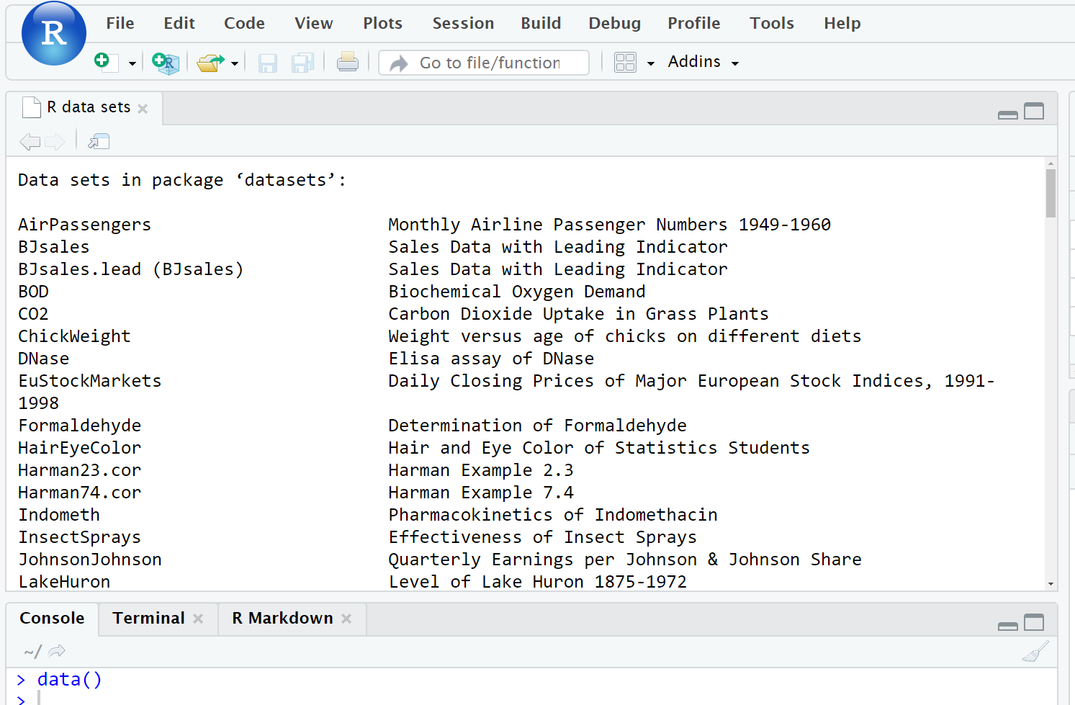
Data frames
Available built-in datasets can be accessed with data()

Slide 40
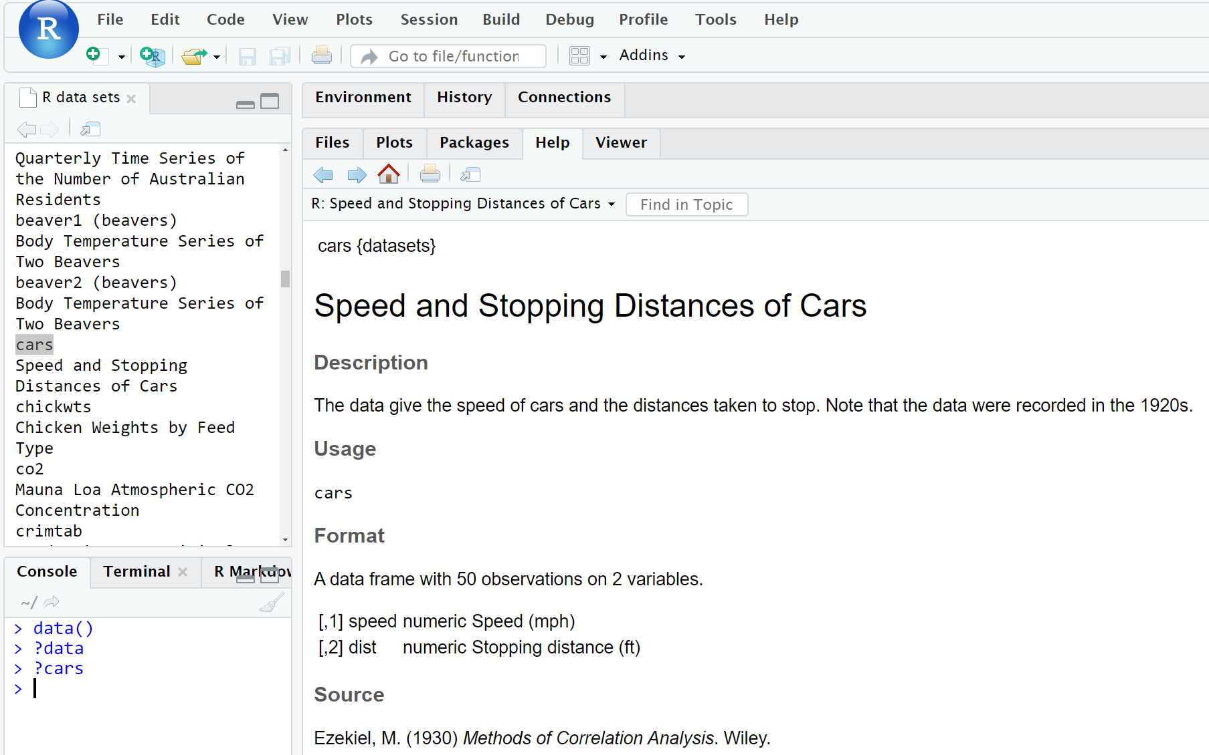
Data frames
Data set information can be accessed with ?dataset

Slide 41
Data frames
The head() function shows the first few lines of a data frame:
> head(cars)
speed dist
1 4 2
2 4 10
3 7 4
4 7 22
5 8 16
6 9 10
>

Slide 42
Functions
Functions are called in the format function(argument)
> head(cars)
Function name
First argument

Slide 43
Functions
Functions can have any number of required arguments or optional arguments
Second argument (optional; default = 6)
> head(cars, 8)
Function name
First argument (required)

Slide 44
Functions
head(cars, 8)will show the first 8 lines of the data frame instead of the default 6:
> head(cars, 8)
speed dist
1 4 2
2 4 10
3 7 4
4 7 22
5 8 16
6 9 10
7 10 18
8 10 26
>

Slide 45
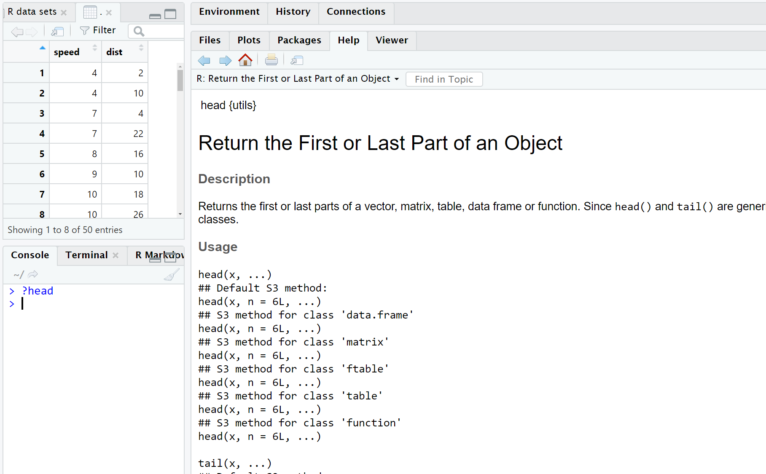
Functions
More information about what a function does and/or requires can be accessed with ?function

Slide 46
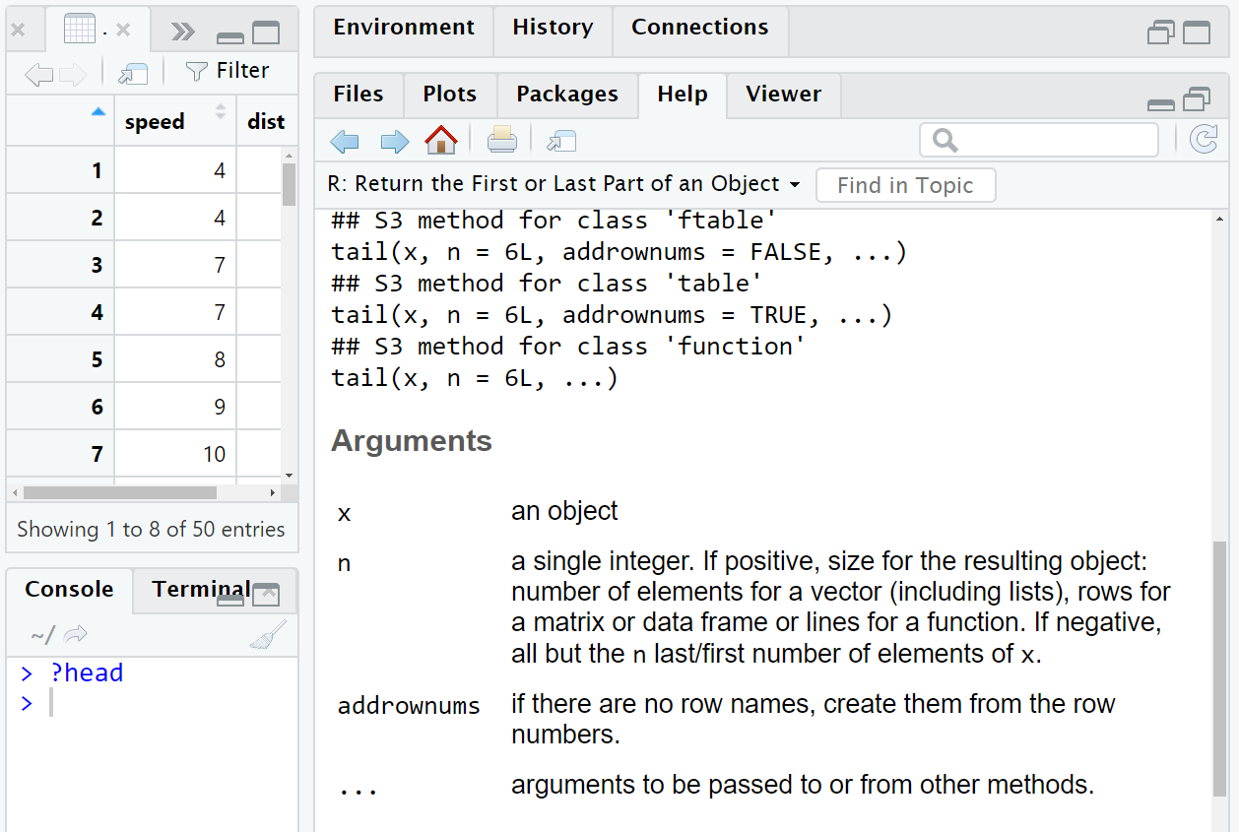
Functions
?function has argument information

Slide 47
Functions
We can implicitly or explicitly pass arguments
> head(cars, 8)
speed dist
1 4 2
2 4 10
3 7 4
4 7 22
5 8 16
6 9 10
7 10 18
8 10 26
>
> head(x=cars, n=8)
speed dist
1 4 2
2 4 10
3 7 4
4 7 22
5 8 16
6 9 10
7 10 18
8 10 26
>

Slide 48
Demonstration Time!
Work on Section #4

Slide 49
Troubleshooting

Slide 50
Ask RStudio for help
Type ?function into console

Slide 51
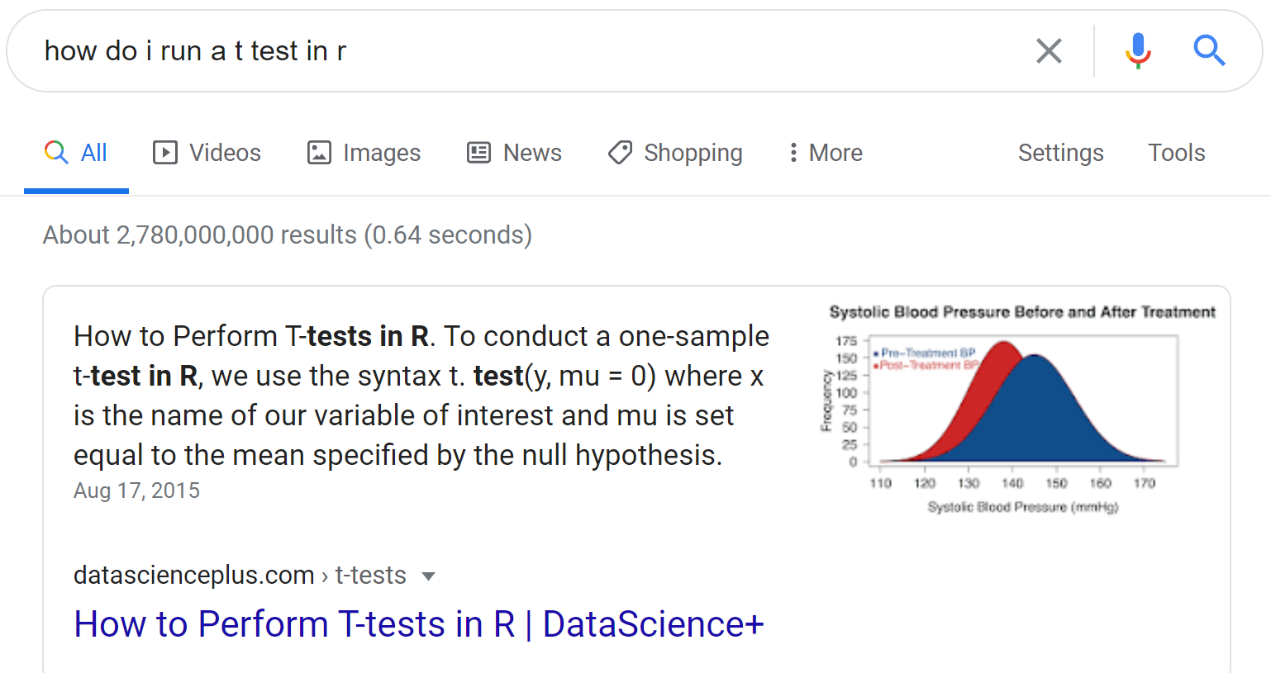
Ask Google for help

Slide 52
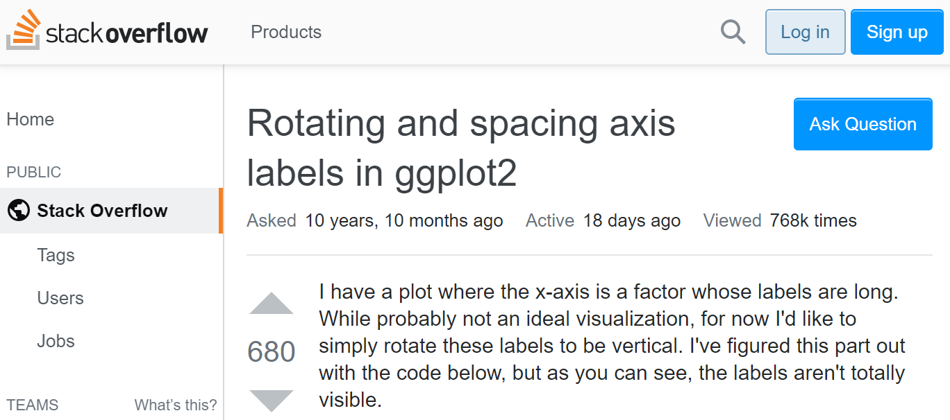
Ask StackOverflow for help

Slide 53
Extending R through packages: There’s a package for everything

Slide 54
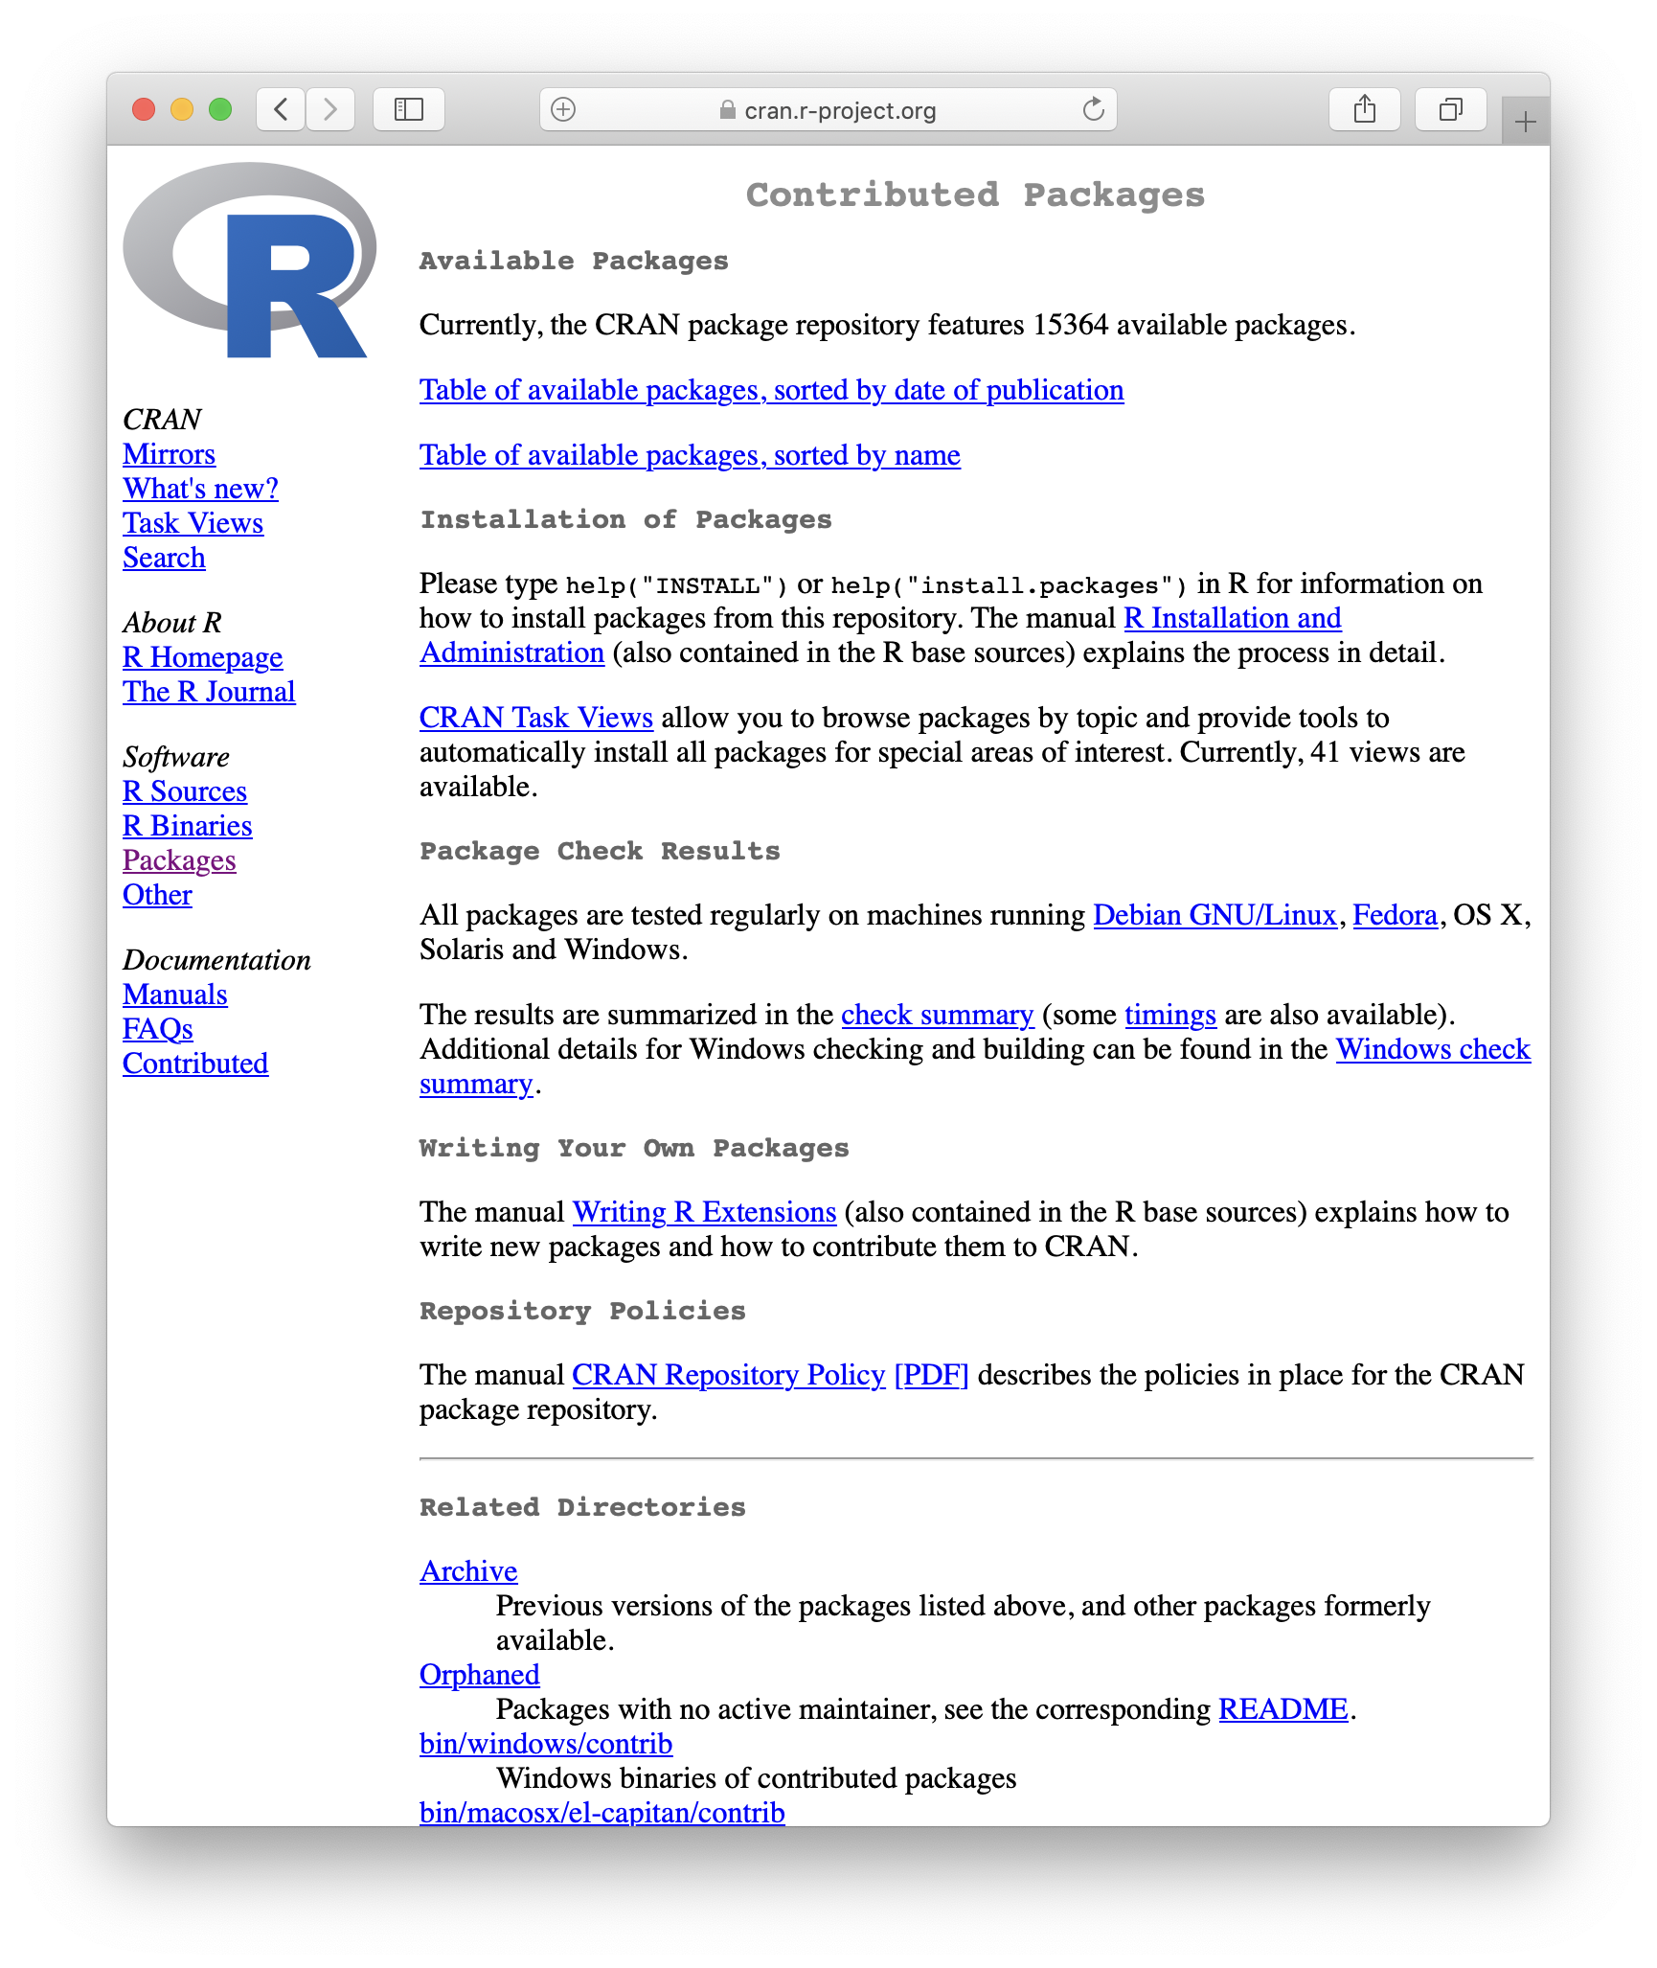
R packages are available on CRAN (Comprehensive R Archive Network)

Slide 55
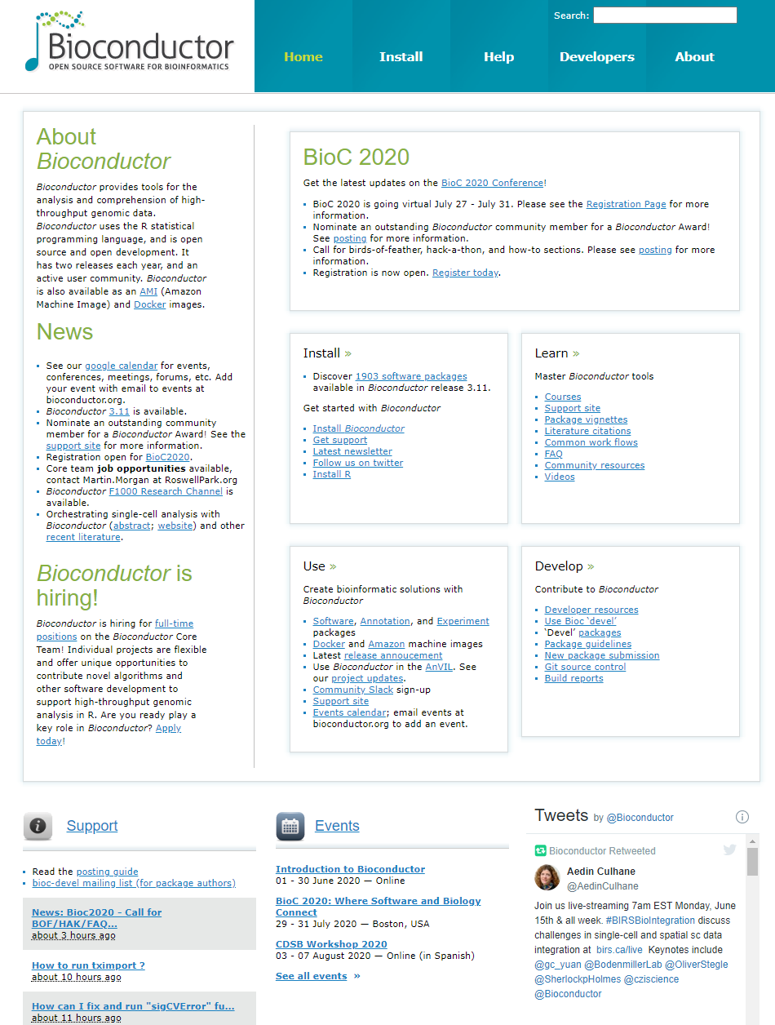
Bio-specific R packages are available on Bioconductor

